Slide 1
Grids
Graph Theory in Grids

Slide 2
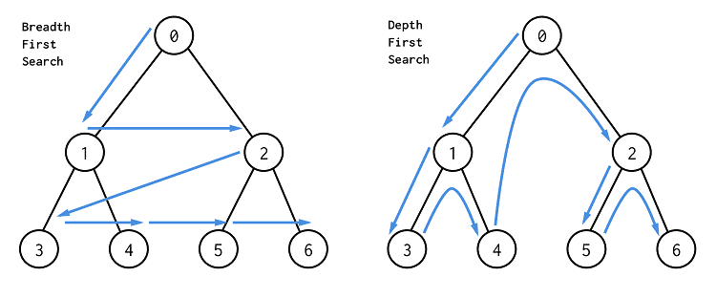
Breadth First Search
Graph traversal algorithm like DFS
Explores all children node before grandchildren
Implemented using a queue

Slide 3
BFS Pseudocode
queue<int> toVisit
toVisit.push(firstNode)
vis[firstNode] = true
while toVisit not empty
currNode = toVisit.front()
for next: adj[currNode]
if not vis[next]
vis[next] = true
toVisit.push(next)

Slide 4
BFS vs DFS
BFS
Queue
Shortest path
Solution is close to root
DFS
Recursive, stack like
Quicker to implement
More often used on trees

Slide 5
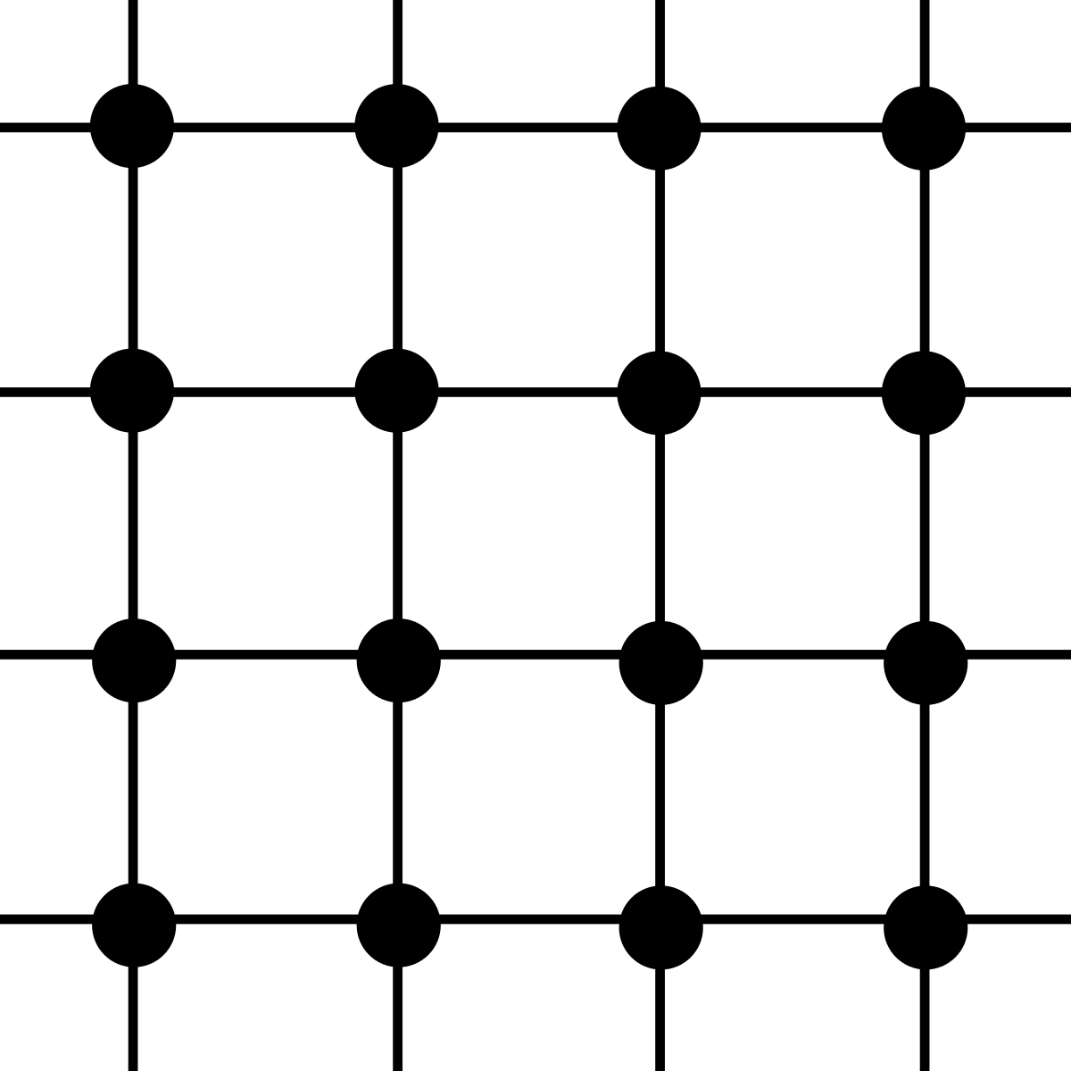
Lattice Graphs
The idea behind graph theory can also be used on a 2D grid/array
You can imagine it as every lattice point is a node and that there is an edge between every adjacent node
Eg. for a node with coordinates (x,y) , it can move to coordinates (x-1,y), (x,y-1), (x+1,,y), (x,y+1)
Up, down, left, right, etc.
Depends on the problem statement
There is no need to create an adjacency list for every single edge
Instead, you can create an array that holds the information of the possible moves that it can make
{{1,0},{-1,0},{0,1},{0,-1}}
newX = newX + array[i][0]; newY = newY + array[i][1];

Slide 6
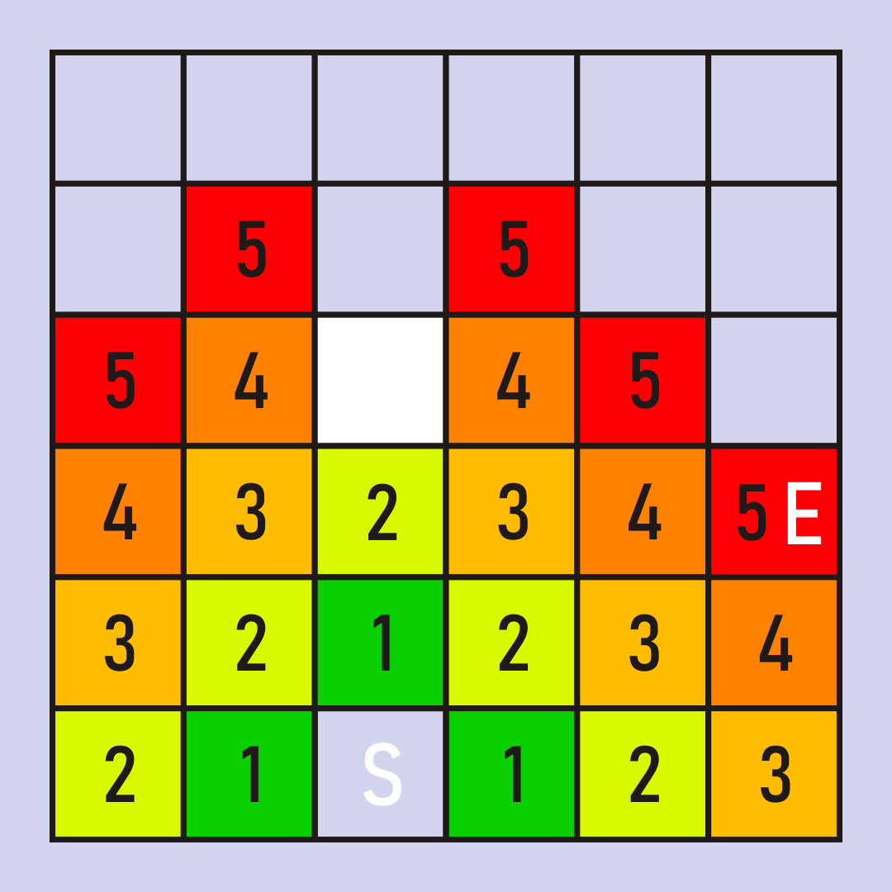
Traversing With BFS
Check squares directly adjacent to current square before other squares
Mark squares as visited so that you do not get stuck in cycle
Usually preferred for grids

Slide 7
Applications
Most problems involving graph theory on grids follow this order of input:
First two numbers is the # of rows and column
Followed by the character representation of the grid
Depending on the problem statement, X can be boundaries/walls, O can be open space
Some problems can have even more different characters that provide additional rules to what needs to be done
L = only move left, R = only move right, etc.
Input:
3 4
XOO
OXX
XOX

Slide 8
Problems
https://dmoj.ca/problem/ccc20s2
https://dmoj.ca/problem/ccc03s3
Challenge:
https://dmoj.ca/problem/ccc18s3
Additional Practice:
https://dmoj.ca/problem/ccc10j5
https://dmoj.ca/problem/dmopc13c3p3
https://dmoj.ca/problem/dmopc14c1p5

